Slide 1

Fuzzy Logic

Slide 2

Fuzzy Logic
Fuzzy Logic was introduced in 1965 by Lofti A. Zadeh in his research paper “Fuzzy Sets”. He is considered as the father of Fuzzy Logic.
Using a term principle of incompatibility, Dr. Zadeh states
"As the complexity of a system increases, our ability to make precise and yet significant statements about its behavior diminishes until a threshold is reached beyond which precision and significance (or relevance) become almost mutually exclusive characteristics.”
[Zadeh, Outline of a new approach to the analysis of complex systems and decision processes, IEEE Trans. on Systems, Man, and Cybernetics, Vol. 3, No. 1, 1973]

Slide 3

In classical logic, which is often described as Aristotelian logic, there are two possible truth values: propositions are either true or false.
Such systems are known as bivalent logics because they involve two logical values.
One early multivalent logic was used to reason about the Uncertainty Principle, used in quantum physics.
This logic had three values: true, false, and undetermined.
Fuzzy concept was introduced as an extension of this three-valued logic , so to represent fuzziness, we consider 0 to represent false, 1 to represent true, and to use real numbers between 0 and 1 to represent degrees of truth.
Classical set contains elements that satisfy precise properties of membership while fuzzy set contains elements that satisfy imprecise /uncertain properties of membership.

Slide 4
Introduction
What is a crisp set?
It is the sets that we consider in the traditional set theory.
A crisp set can be defined by the values that are contained within it.
A value will be having only one of the two possibilities i.e. is either within the crisp set, or it is not.
For example, the set of natural Numbers is a crisp set: 1, 2, 3, 4, and so on are natural numbers and so are definitely members of the set of natural numbers.
Numbers such as 0.2, 101.101, and are definitely not members of the set of natural numbers.

Slide 5
Introduction
The term fuzzy is associated with things which are not very clear or vague.
In real life, we may come across a situation where we can't decide whether the statement is true or false .
At that time, fuzzy logic offers very valuable flexibility for reasoning.
We can also consider the uncertainties of any situation.
The FL method imitates the way of decision making in a human which consider all the possibilities between digital values T and F.
Fuzzy logic enables processing with words of speech.
Each fuzzy variable can take a value from 0 (not at all true) to 1 (entirely true) but can also take on real values in between. Hence, 0.5 might indicate “somewhat true,” or “about as true as it is false.”
Fuzzy sets contrast with the sets used in traditional set theory- crisp sets
Fuzzy logic is used to reason about fuzzy sets.

Slide 6
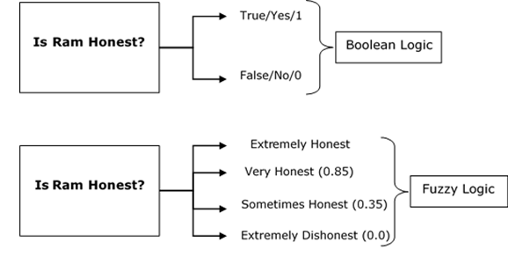
See the below-given diagram.
It shows that in fuzzy systems, the values are denoted by a 0 to 1 number. In this example, 1.0 means absolute truth and 0.0 means absolute falseness.
The number which indicates the value in fuzzy systems is called the truth value.
Fuzzy logic enables processing with words of speech.

Slide 7
Probability Vs Fuzzy
In probability theory we are dealing with uncertainty (at the moment we don’t know whether the proposition will be true or false, but it will definitely either be true or false—not both, not neither, and not something in between)
If a fact has a probability value of 0.5, then it is as likely to be true as it is to be false, but in fact it will only be either true or false.
In Multivalent logic, we are certain of the truth value of the proposition; it is just vague—it is neither true nor false, or it is both true and false.

Slide 8
Fuzzy Set
Strictly speaking, a fuzzy set A is a collection of ordered pairs A = {(x, μ(x))}
Item x belongs to the universe and μ (x) is its grade of membership in A.
A single pair (x, μ (x)) is called a fuzzy singleton;

Slide 9
Fuzzy sets
Example : Consider the set of tall people. Bill is 7 feet tall, and so it is pretty clear that he is included in the set of tall people. John is only 4 feet tall, and so most would say that he is not included in the set. What about jane, who is 5 feet 10 inches tall? Some would certainly say she is tall, but others would say she is not.
The fuzzy set of tall people contains Bill, and it also contains Jane, and it even contains John.
Each is a member of the set to some degree and is not a member of the set to some degree.
This can be seen in the chart in Figure 18.1, which shows the degree of membership that a person of a given height has in the fuzzy set of tall people.

Slide 10
Membership Function
Fuzzy logic is not logic that is fuzzy but logic that is used to describe fuzziness.
This fuzziness is best characterized by its membership function.
In other words, we can say that membership function represents the degree of truth in fuzzy logic.
Membership functions characterize fuzziness (i.e., all the information in fuzzy set), whether the elements in fuzzy sets are discrete or continuous
Definition: a membership function for a fuzzy set A on the universe of discourse X is defined as µ_{A}:X → [0,1], where each element of X is mapped to a value between 0 and 1.
This value, called membership value or degree of membership, quantifies the grade of membership of the element in X to the fuzzy set A.

Slide 11
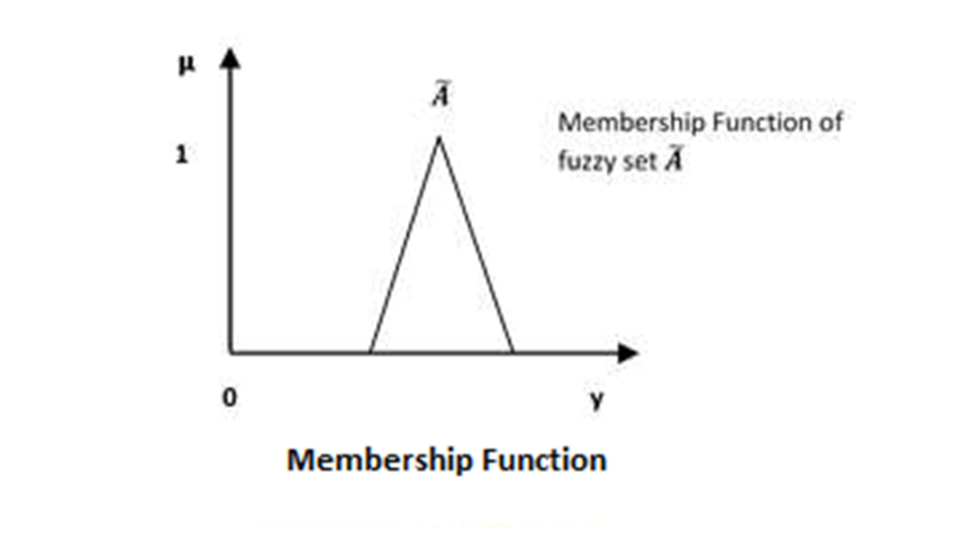

Slide 12
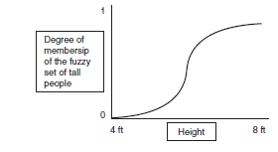
Chart showing the membership function for the fuzzy set of tall people
The fuzzy set of tall people contains Bill, and it also contains Jane, and it even contains John.
Each is a member of the set to some degree and is not a member of the set to some degree.
This can be seen in the chart in Figure , which shows the degree of membership that a person of a given height has in the fuzzy set of tall people

Slide 13
Fuzzy sets are functions that map each member in a set to a real number in [0, 1] to indicate the degree of membership of that member.
Each fuzzy variable can take a value from 0 (not at all true) to 1 (entirely true) but can also take on real values in between. Hence, 0.5 might indicate “somewhat true,” or “about as true as it is false.”

Slide 14
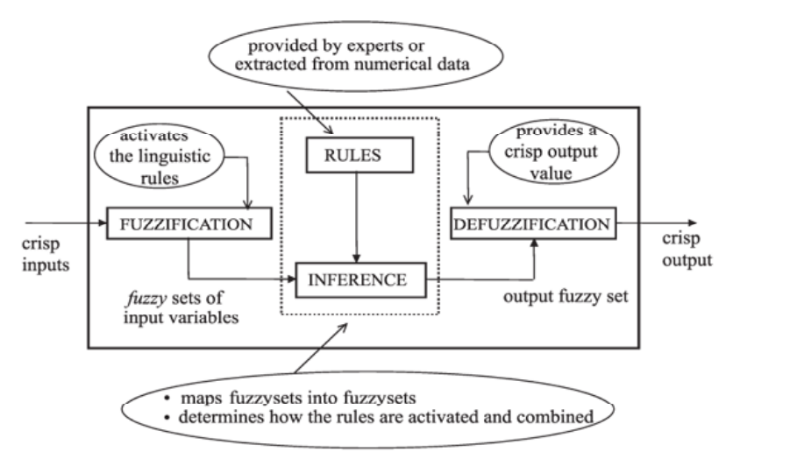
A Fuzzy Logic System.

Slide 15
Firstly, a crisp set of input data are gathered and converted to a fuzzy set using fuzzy linguistic variables, fuzzy linguistic terms and membership functions.
This step is known as fuzzification.
Afterwards, an inference is made based on a set of rules.
After the inference step, the overall result is a fuzzy value
Lastly, the resulting fuzzy output is mapped to a crisp output using the membership functions, in the defuzzification step.
This is the purpose of the defuzzifier component of a FLS.

Slide 16
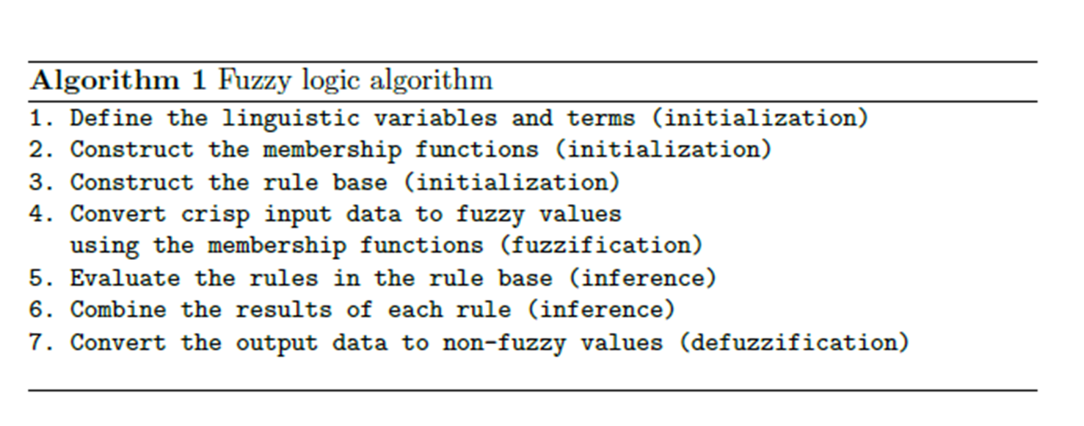

Slide 17
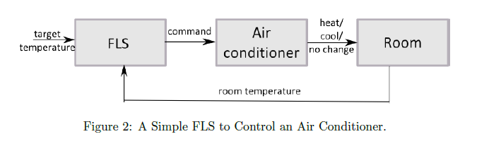
In order to exemplify the usage of a FLS, consider an air conditioner system controlled by a FLS (figure 2).
The system adjusts the temperature of the room according to the current temperature of the room and the target value.
The fuzzy engine periodically compares the room temperature and the target temperature, and produces a command to heat or cool the room.

Slide 18
Linguistic Variables
In fuzzy set theory and fuzzy logic, we make great use of linguistic variables.
Linguistic variables are the input or output variables of the system whose values are words or sentences from a natural language, instead of numerical values.
A linguistic variable is a concept such as “height,” which can have a value from a range of fuzzy values including “tall,” “short,” and “medium.”
The linguistic variable “height” may be defined over the universe of discourse from 2 feet up to 8 feet. As we will see, the values “tall,” “short,” and “medium” define subsets of this universe of discourse.
A linguistic variable is generally decomposed into a set of linguistic terms.

Slide 19
Example: Consider the air conditioner in Figure 2.
Let temperature (t) is the linguistic variable which represents the temperature of a room.
To qualify the temperature, terms such as \hot" and \cold" are used in real life.
These are the linguistic values of the temperature.
Then, T(t) = { too-cold, cold, warm, hot, too-hot }can be the set of decompositions for the linguistic variable temperature.
Each member of this decomposition is called a linguistic term and can cover a portion of the overall values of the temperature.

Slide 20
Hedges
A linguistic hedge or a modifier can be defined as an operation that modifies the meaning of a term or, more generally, of a fuzzy set.
If A is a fuzzy set then the modifier m generates the (composite) term B = m(A)
A hedge is a fuzzy set qualifier, such as “very,” “quite,” “extremely,” or “somewhat.“
When one of these qualifiers is applied to a fuzzy set, such as “tall people,” we produce a new set.
For example, by applying the “very hedge to “tall people,” we produce a subset of “tall people” called “very tall people.”
Similarly we can produce a new subset of “quite tall people” or “somewhat tall people.”

Slide 21
Hedges
Often a hedge is applied by raising the set’s membership function to an appropriate power.
For example, it is common to consider the “very” hedge to square the value of the membership function.
For example, if MA is the membership function for fuzzy set A of tall people, then the membership function for VA- the fuzzy set of very tall people is
MVA (x) = (MA (x))2
Similarly, we can define hedges such as “quite,” “somewhat,” and “extremely,” as raising the membership function to powers of 1.3, 0.5, and 4, respectively.

Slide 22
Fuzzy Inference Engine
The fuzzy inference system is a popular computing framework based on the concepts of fuzzy set theory, fuzzy if-then rules, and fuzzy reasoning.
It has found successful applications in a wide variety of fields, such as automatic control, data classification, decision analysis, expert systems time series prediction, robotics, and pattern recognition.
Because of its multidisciplinary nature, the fuzzy inference system is known by numerous other names, such as fuzzy-rule-based system, fuzzy expert system, fuzzy model, fuzzy associative memory, fuzzy logic controller, and simply (and ambiguously) fuzzy system

Slide 23
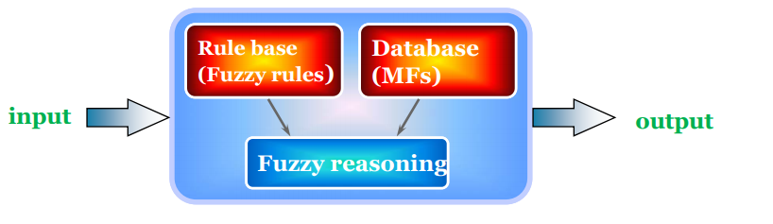
The basic structure of a fuzzy inference system consists of three conceptual components:
A rule base, which contains a selection of fuzzy rules;
A database (or dictionary), which defines the membership functions used in the fuzzy rules;
And a reasoning mechanism, which performs the inference procedure upon the rules and given facts to derive a reasonable output or conclusion.

Slide 24
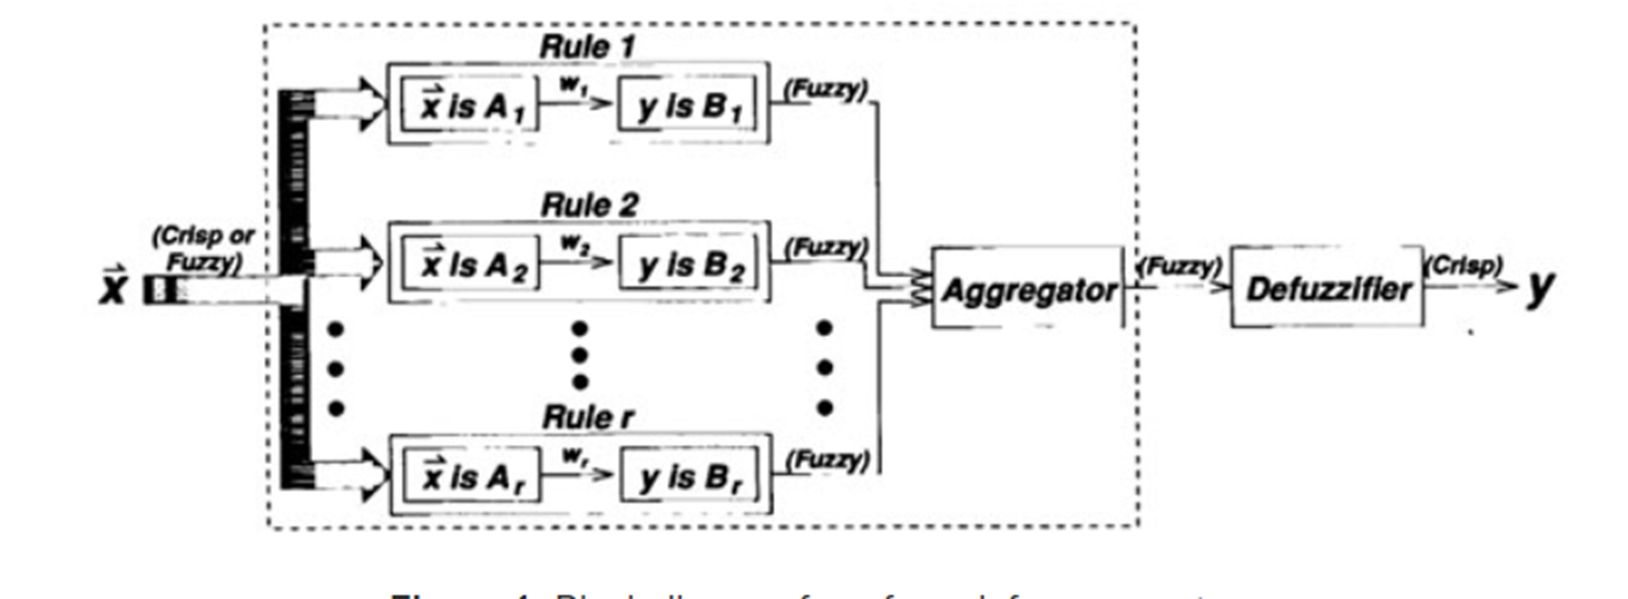
Block Diagram For A Fuzzy Inference System

Slide 25
The basic fuzzy inference system can take either fuzzy inputs or crisp inputs (which are viewed as fuzzy singletons), but the outputs it produces are almost always fuzzy sets.
Sometimes it is necessary to have a crisp output, especially in a situation where a fuzzy inference system is used as a controller.
Therefore, we need a method of defuzzification to extract a crisp value that best represents a fuzzy set.
A fuzzy inference system with a crisp output is shown in previous figure, where the dashed line indicates a basic fuzzy inference system with fuzzy output and the defuzzification block serves the purpose of transforming an output fuzzy set into a crisp single value.

Slide 26
The most frequently used fuzzy inference systems are:
Mamdani Fuzzy Models;
Sugeno Fuzzy Models (Also known as Takagi-Sugeno or TSK Fuzzy Model);
Tsukamoto Fuzzy Models;

